Slide 1
WORKSHOP OBJECTIVES/EXPECTATIONS
Develop simple malaria models applicable to the Kenyan context
Introduce practical application of malaria modeling using R and R studio Software
Use data from the National Malaria Control Program to perform numerical simulations on the developed models.

Slide 2
OVERVIEW OF DIFFERENT TYPES OF MODELS
INTRODUCTION:
Deterministic and Stochastic models
A deterministic model is a model where the output is fully determined: By the parameter values and their initial conditions. The do not contain the element of probability.
Stochastic models are models where the output contain the element of probability. Parameters are given in ranges.

Slide 3
DYNAMIC MODELS
Dynamic Models describe those aspects of a system concerned with time and the sequencing of operations.
The Dynamic Model is represented graphically by a set of State Diagrams.
A State Diagram shows the states and the transitions between states together with its responses to external events.

Slide 4
.
These models may take subsets of populations as a state which is the unit of calculation
Compartmental Models
S I R

Slide 5
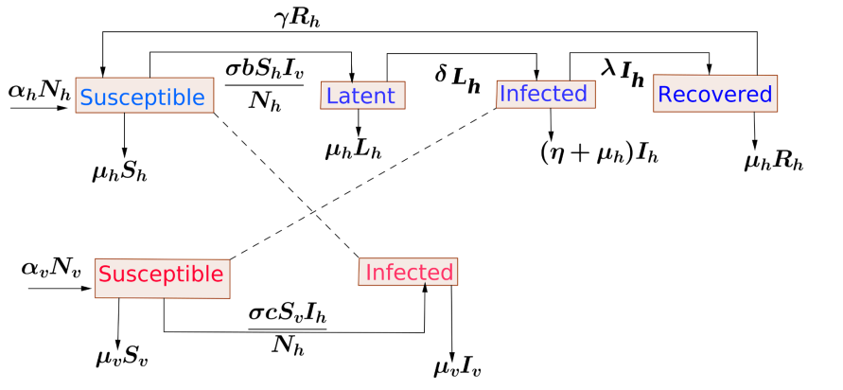

Slide 6
GENOMIC MODELING (AI Models)
Models the extent to which interventions manifested in genetic changes affects the parasite population in future.
Genetic changes include, reduced genetic variation, greater self-fertilization during transmission, identity by descent etc.
Given the changes in parasite genomics due to interventions, an epidemiological model that incorporates parasite genotypes can be developed to estimate the changes in epidemiological parameters and malaria dynamics

Slide 7
An epidemiological model that incorporates parasite genotypes can reproduce barcode/gene patterns that can lead to a reduction of transmission over some years
Estimates of epidemiological parameters such as transmission intensity would aid in predicting the prevalence in future.

Slide 8
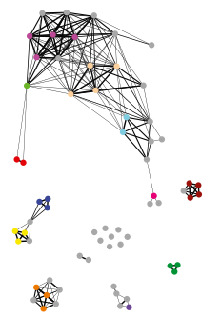
Barcode relatedness based on genetic distances between barcodes due to interventions

Slide 9
Genetic distances between barcodes may be due to some interventions
The changes in genetic distances could reduce or increase infection/transmission

Slide 10
GEOSPATIAL MODELING (AI)
These include modeling malaria incidence and prevalence by assessing the relationship between malaria and environmental variables
Involves using Spatial technologies, i.e. geographic information systems, remote sensing, and global positioning systems mapped/coupled with malaria prevalence/incidence data.
Given temperatures linked to given prevalence

Slide 11
It provides reliable estimates of population at risk from spatial technologies/maps.
Predict disease distributions in areas that lack baseline data and provide guidance for intervention strategies.
The potential of new spatial technology applications utilising emerging satellite information, hold promise to further enhance infectious risk mapping and disease prediction to control and eliminate the disease.

Slide 12
COMPARTMENTAL MODELS
Formulation
Simulation
Validation

Slide 13
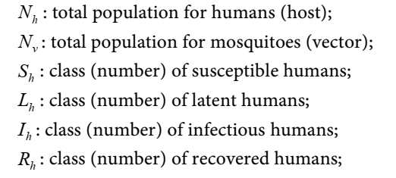
Common Malaria Models: SEIR Egide & Paterne 2021 E. Ndamuzi & P. Gahungu (2021)

Slide 14

VECTOR VARIABLES/MOSQUITO POPULATION

Slide 15
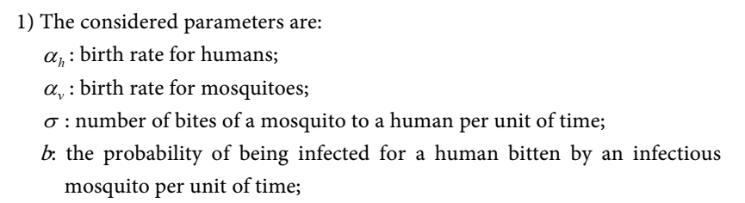
.

Slide 16
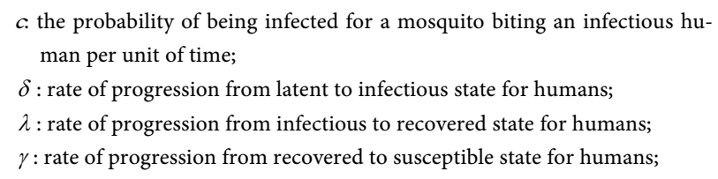
.

Slide 17
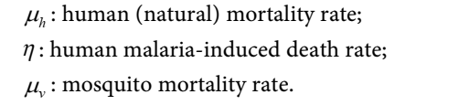
.

Slide 18
MODEL FLOW CHART & EQUATIONS
The model flow chart is a representation of the interactions of the various disease status compartments of the model.
It captures the flow of individuals in and out of the various compartments.

Slide 19
.

Slide 20
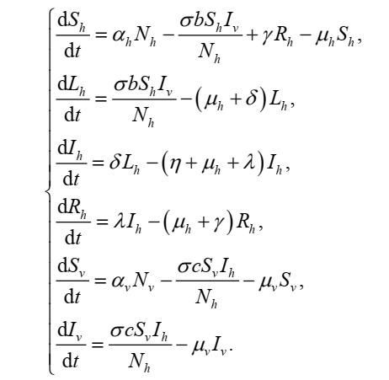
.

Slide 21
MODEL SIMULATION:LOADING LIBRARIES
library(caret)
library(pROC)
library(e1071)
library(class)
library(caTools)
library(MASS)
library(ISLR)
library(flextable)
library(lorenz)
library(deSolve)
library(reshape2)
library(lattice)
library(ggplot2)
library(psych)
library(tidyverse)
library(mlbench)
library(mltools)
library(caretEnsemble)
library(tictoc)
library(haven)
library(foreign)
library(diffeqr)

Slide 22
Solving a simple SIR Model Inbuilt in R: The graphs S,I,R drawn separately
# Define the ODE system (Only for SIR compartments)
SIR_model <- function(t, y, parms) { with(as.list(c(y, parms)),
{ dS <- -beta * S * I
dI <- beta * S * I - gamma * I
dR <- gamma * I
return(list(c(dS, dI, dR))) })}

Slide 23
Proportion of Initial conditions
y0 <- c(S = 0.99, I = 0.01, R = 0)
# define the parameters
parameters <- c(beta = 0.3, gamma = 0.1)
# Time vector
times <- seq(0, 200, by = 0.1)
# Solve the ODE system
solution <- ode(y = y0, times = times, func = SIR_model, parms = parameters)

Slide 24
# Plot the solution with the graphs of S, I and R drawn separately
plot(solution, main = "SIR Model for Infectious Diseases", xlab = "Time", ylab = "Proportion")

Slide 25
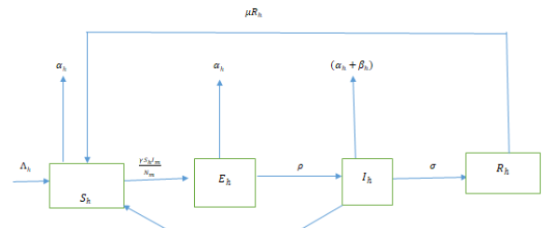

Slide 26
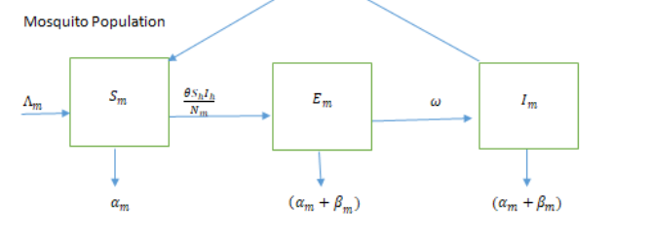

Slide 27
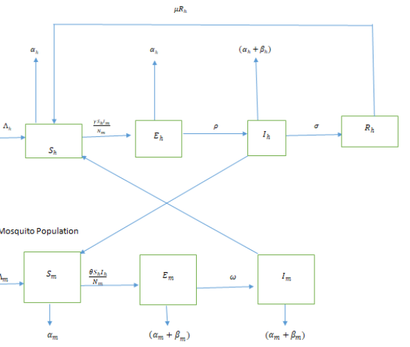
.

Slide 28
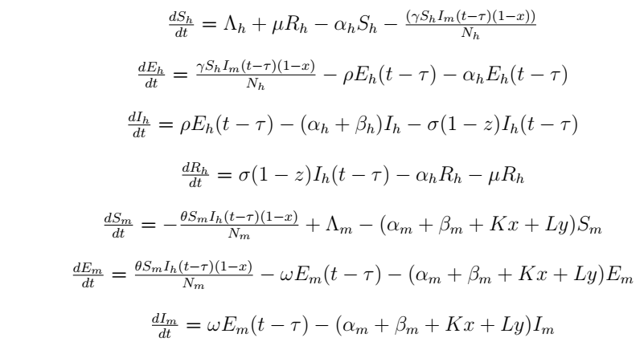
.

Slide 29
.
Humans and mosquitoes birth rates, Λh and Λm
Humans and mosquitoes death rates αh and αm
disease induced death rates at specific rates, βh and βm respectively.
Members of exposed class (Eh) move to infected human class (Ih) at a rate ρ(Eh)

Slide 30
Individuals in the infected class move to recovered class at a rate , σ(Ih).
Individuals in the recovered class move to susceptible class at a rate µ(Rh)
Susceptible mosquitoes move to exposed class at a rate (ƟSmIh)/Nm
mosquitoes in the exposed class move to infectious class at the rate w(Em)

Slide 31
MODEL THREE: Gbenga et al 2023 (TSEIRDVAB)
T- Travelers compartments
S- Susceptible
E - Exposed
I - Infected
R - Recovered
D - Deaths
V – Vigilant human population
A - Susceptible adult female Anopheles
B – Infected adult anopheles mosquito

Slide 32
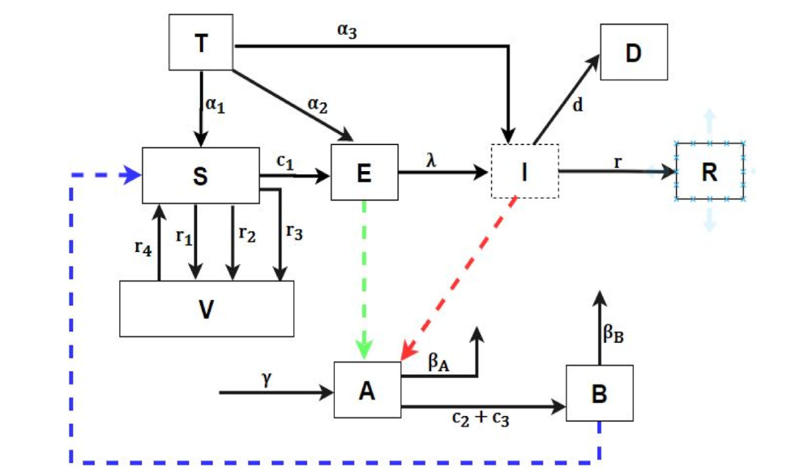

Slide 33
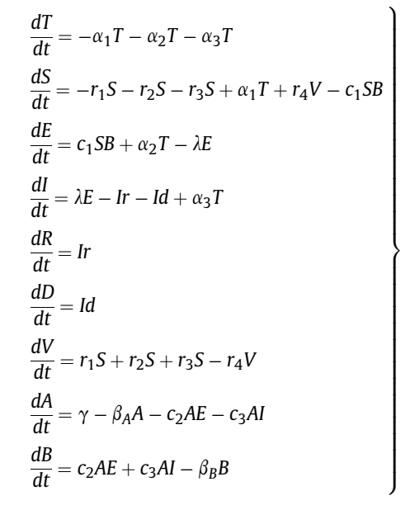

Slide 34
T is the human Traveller's Population variable, a1 is the parameter representing the rate of influx of human Travellers into the Susceptible human Population of a given locality, a2 is the parameter representing the rate of influx of the human Travellers into the human Exposed Population of a given locality, a3 is the parameter representing the rate of influx of human Travellers into the human Infected Population of a given locality, S is the Susceptible human population variable, r1 is the parameter representing the rate of use of LLIN, r2 is the parameter representing the rate of use of IRS,
T- is the human Travelers
a1 -rate of influx of T into S
a2 -rate influx of T into E
a3 -rate of influx of T into I
S -the Susceptible human population

Slide 35
r1 - the rate of use of LLIN,
r2 - rate of use of IRS, r3 - rate of use of traditional malaria control strategies such as lotion, etc
r4 - rate of non-adherence to the use of the LLIN

Slide 36
R - the Recovered human population variable,
D - the human death population variable,
V - the Vigilant human population variable,
A - the Susceptible adult female Anopheles mosquito
B- the Infected adult female Anopheles mosquito.

Slide 37
C2 - the parametric constant representing the contact rate between the female Susceptible mosquito (A) and Exposed human (E) Population of a given locality,
C3 - the parametric constant representing the contact rate between the Susceptible mosquito (A) and infected human (I).
g - the recruitment rate of the female anopheles mosquitoes,

Slide 38
MODEL FOUR: Koutou et al. (2018)
Mathematical modeling of malaria transmission global dynamics:
Taking into account the immature stages of the vectors

Slide 39
Four different stages of the mosquito growth dynamics, • E(t): the number of eggs at the moment t; • L(t): the number of larvae at the moment t; • P(t): the number of pupae at the moment t; • A(t): the number of females at the moment t. • b: the intrinsic egg-laying rate; • SE, SL, SP: respectively, the rates of transfer from eggs to larvae, from larvae to pupae, and from pupae stage to females. • dE, dL, dP, fm: respectively, the natural death rate of eggs, larvae, pupae, and females

Slide 40
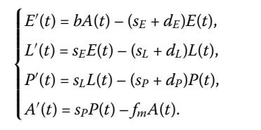

Slide 41
The growth of eggs depends on the availability of the nutrients. It also depends on the availability of the space because, the oviposition habitat selection is made taking into account the possibility of development of larvae and pupae.

Slide 42
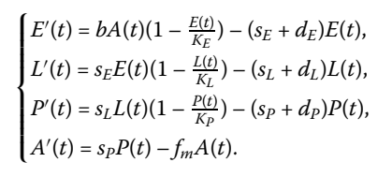

Slide 43
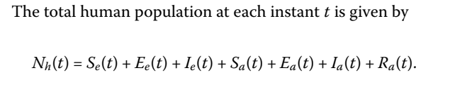

Slide 44
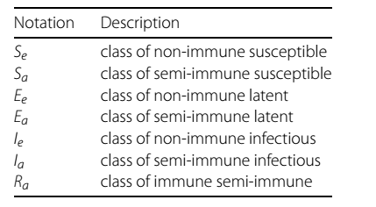

Slide 45
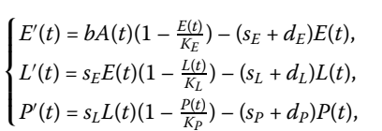

Slide 46
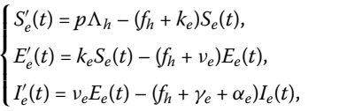

Slide 47
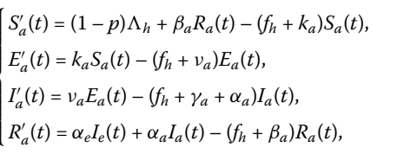

Slide 48
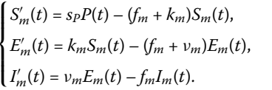

Slide 49
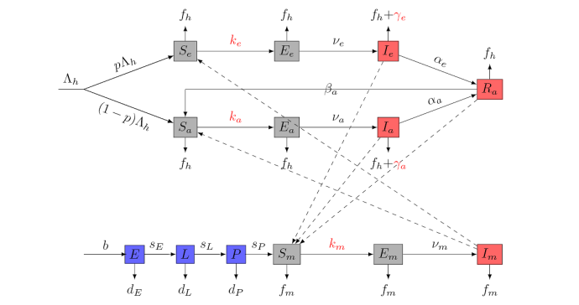

Slide 50
REPRODUCTION NUMBER: MODEL ONE
DEFINITION
The Basic reproduction number is the expected number of secondary cases produced by a single infection in a completely susceptible population.
It is a measure of how fast a disease spreads through a population. The Basic reproduction number (R0) is obtained by taking the largest dominant eigenvalue

Slide 51

MATHEMATICALLY THE BASIC REPRODUCTION NUMBER IS DEFINED AS

Slide 52
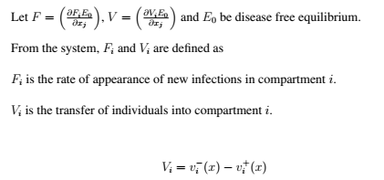

Slide 53
Model one (Egide & Paterne 2021 )

Slide 54
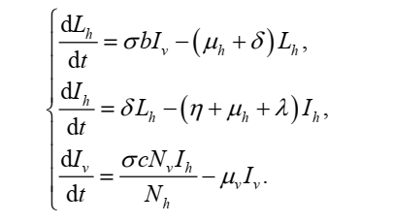

Slide 55
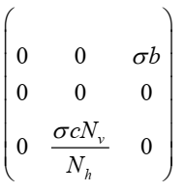
MATRIX (F)

Slide 56
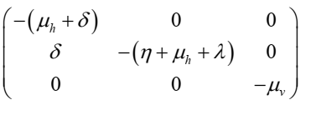
MATRIX (V)

Slide 57
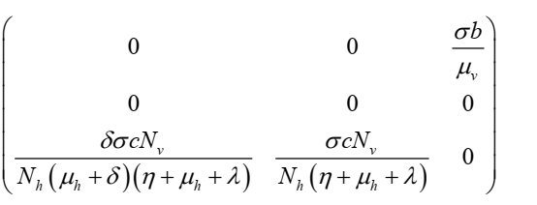
MATRIX (FV-1)

Slide 58
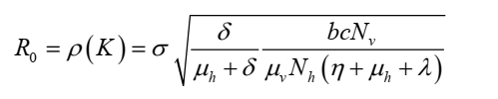
The Basic Reproduction Number (R 0)

